Slide 1
Data Science: It’s Easy as Py!
Michael Becker
@beckerfuffle
#PyDataNYC
Notes:
Thanks everybody for coming to my talk! My name is Michael Becker, I work on the Data Ninjas Team at AWeber. AWeber is an email service provider located just outside of Philadelphia. I’m also the founder of the DataPhilly meetup with over 800 members.

Slide 2
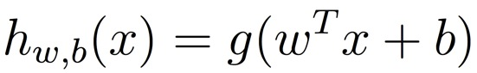
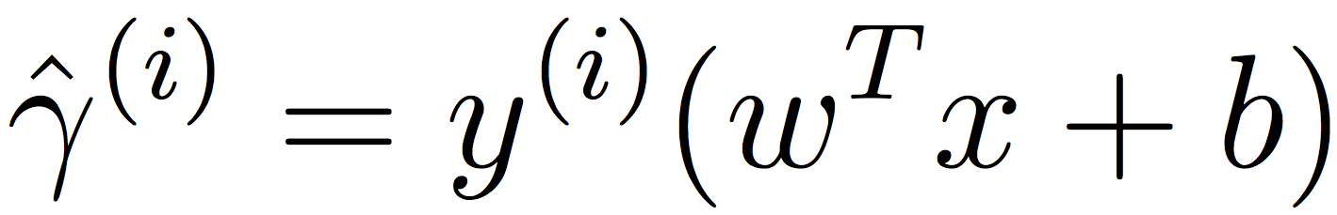
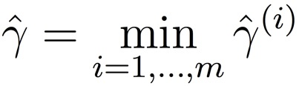
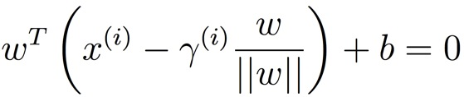
What My Coworkers Think I Do
@beckerfuffle
#PyDataNYC
Notes:
Working on the DAMN team at AWeber, I’ve introduced several predictive algorithms into our application. My co-workers think I’m some kind of math superhero, reading scholarly papers by day and fighting crime by night! The truth is much more sinister.

Slide 3
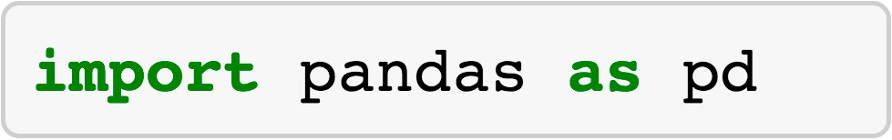
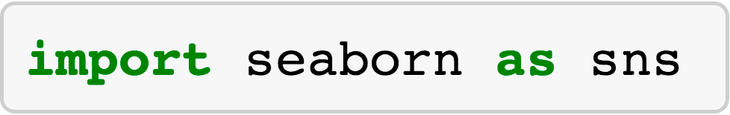

What I Actually Do
@beckerfuffle
#PyDataNYC
Notes:
Fortunately for me, I don’t have to be a genius to look like a superhero, I just have to use python! While I’ll cover some math in this talk, I’ll mainly be keeping things high-level.

Slide 4
What I'll Cover
What is Data Science?
@beckerfuffle
#PyDataNYC
Notes:
Okay, so what will I be covering today? To start off I’ll define what Data Science is.

Slide 5
What I'll Cover
What is Data Science?
The OSEMN process
@beckerfuffle
#PyDataNYC
Notes:
I’ll teach you the OSEMN Data Science process.

Slide 6
What I'll Cover
What is Data Science?
The OSEMN process
Writing a custom web scraper
@beckerfuffle
#PyDataNYC
Notes:
I’ll demonstrate how to create a custom web scraping bot

Slide 7
What I'll Cover
What is Data Science?
The OSEMN process
Writing a custom web scraper
Scrubbing the data
@beckerfuffle
#PyDataNYC
Notes:
I’ll convert the data to plain text.

Slide 8
What I'll Cover
What is Data Science?
The OSEMN process
Writing a custom web scraper
Scrubbing the data
Data Exploration
@beckerfuffle
#PyDataNYC
Notes:
I’ll explore the data using pandas, seaborn, and scikit-learn

Slide 9
What I'll Cover
What is Data Science?
The OSEMN process
Writing a custom web scraper
Scrubbing the data
Data Exploration
Predictive Modeling
@beckerfuffle
#PyDataNYC
Notes:
Finally I’ll walk you through creating a predictive model using scikit-learn

Slide 10
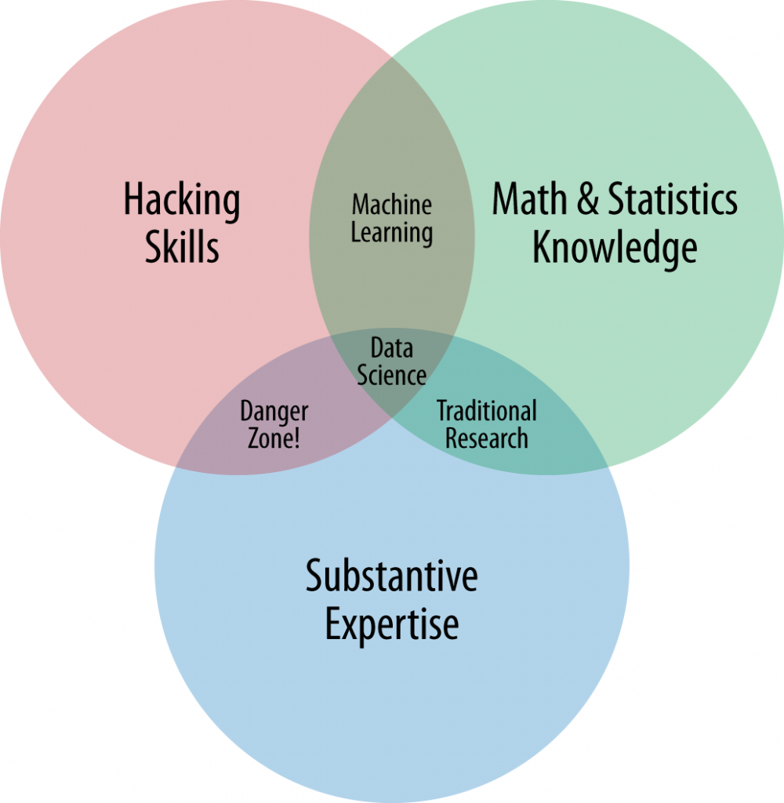
What is Data Science?
http://www.dataists.com/2010/09/the-data-science-venn-diagram/
@beckerfuffle
#PyDataNYC
Notes:
This data science Venn diagram created by Drew Conway gives a good high level overview of what skills are involved in Data Science. Conway argues that at a minimum, one needs 3 main skills to be a good Data Scientist. Hacking skills, Math & statistics, and substantive expertise.
In the “Hacking Skills” circle, he includes things like “manipulating text files at the command-line” and “thinking algorithmically”
The Math & Statistics part is pretty straight forward.
Drew argues that these 2 pieces are not enough on their own, you also need to understand the data, you need domain knowledge and expertise.

Slide 11

@beckerfuffle
#PyDataNYC
Notes:
I’m not sure if it was Hilary Mason who first coined the term OSEMN, but that’s certainly who I learned it from. OSEMN is a typical data science process followed by many data scientists. Let’s break it down.

Slide 12
OSEMN!
Obtain
@beckerfuffle
#PyDataNYC
Notes:
Obtain is pretty straight forward. To do Data Science, you first need data. Not all data is easy to access. Be prepared to jump through some of hoops to obtain your datasets.

Slide 13
OSEMN!
Obtain
Scrub
@beckerfuffle
#PyDataNYC
Notes:
Okay, so you have your dataset, now what? If your lucky, your data will be well structured and easily parseable. But in reality, it’s rarely that simple. Messy data is the norm, not the exception. But don’t panic, scrubbing your data just another part of the job!

Slide 14
OSEMN!
Obtain
Scrub
Explore
@beckerfuffle
#PyDataNYC
Notes:
To get the most out of your dataset, you need to understand it. This is where the Explore step comes in. This can be as simple as looking at your raw data in a text editor, or as advanced as running machine learning algorithms on your data.

Slide 15
OSEMN!
Obtain
Scrub
Explore
Model
@beckerfuffle
#PyDataNYC
Notes:
Sometimes you want to predict the future using your data! This is usually where machine learning comes into the picture. The goal here is to maximize predictive power by minimizing the level of error.

Slide 16
OSEMN!
Obtain
Scrub
Explore
Model
iNterpret
@beckerfuffle
#PyDataNYC
Notes:
An model isn’t useful on it’s own. This is where the interpret step comes in. Often while interpreting the results of your model, you’ll identify areas for improvement which will allow you to iterate and improved on it. Even a bad model can lead to useful insights.

Slide 17
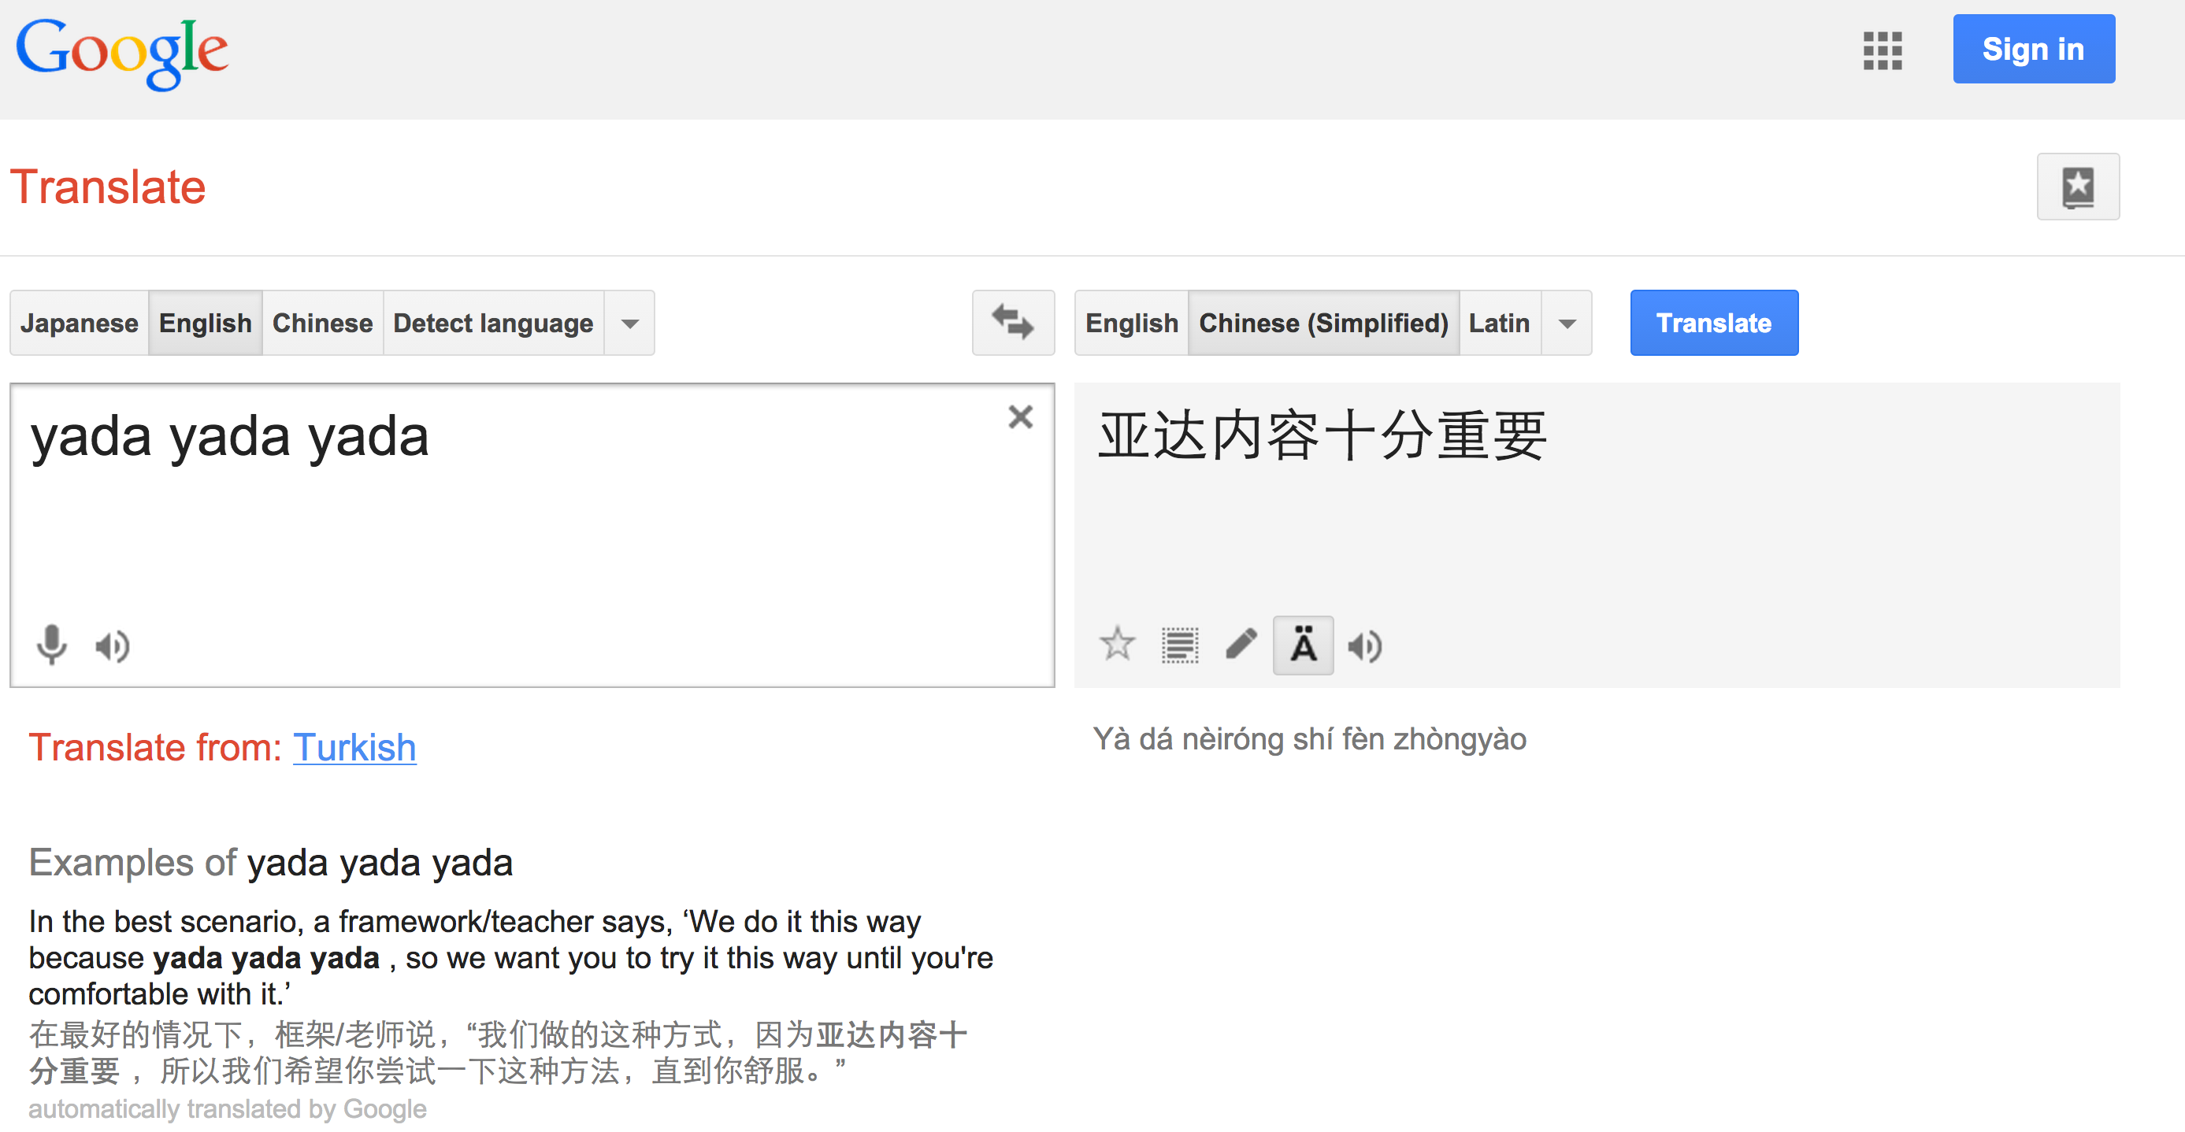
Language Classification
@beckerfuffle
#PyDataNYC
Notes:
In this talk I’m going to walk you through the OSEMN process by building a language classification algorithm from scratch. Language classification can be useful on its own. For example, I’ve used this algorithm break down AWeber’s customers by the language they use in their emails.
Language classification can also be useful as a preprocessing step. For example, Google likely uses it to figure out which machine translation model to use in google translate.

Slide 18

Obtain
API?!
Where we’re going we don’t need APIs!
@beckerfuffle
@beckerfuffle
#PyDataNYC
#PyDataNYC
Notes:
Step one is to obtain the data. In the case of our language classification model, we need text in a bunch of different languages. Fortunately, Wikipedia has an abundant supply of this kind of data. There are a Wikipedia datasets available online, but that’s no fun! Let’s build our own!

Slide 19
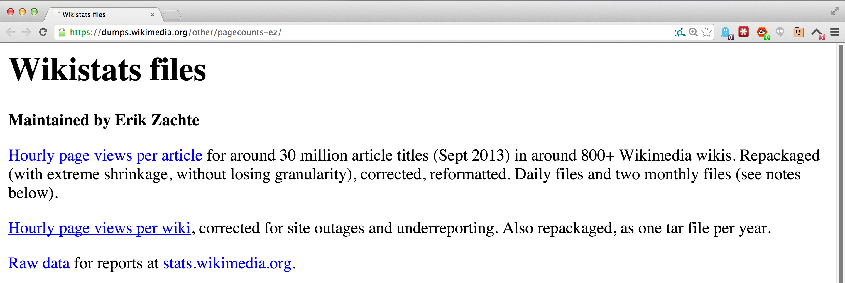
Scrape All The Things!
@beckerfuffle
#PyDataNYC
Notes:
To start off, I grabbed a list of hourly page view. I wrote some scripts to aggregate this data for several months, and compiled a list of the top articles per language.

Slide 20
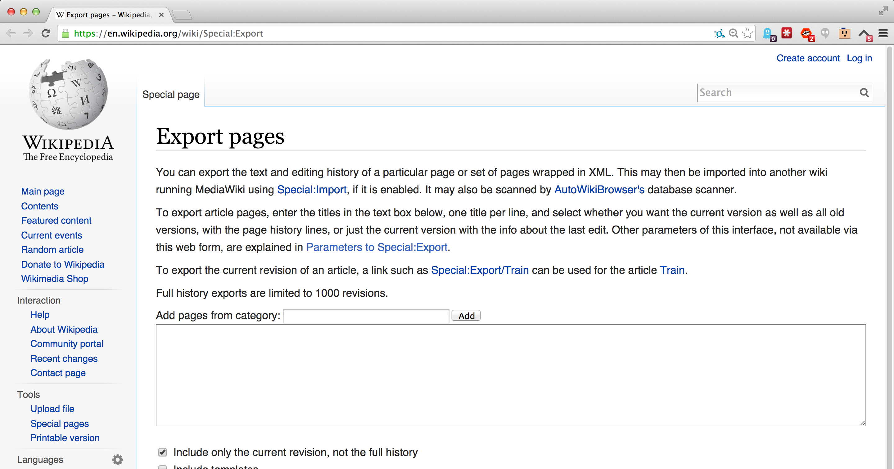
Scrape All The Things!
@beckerfuffle
#PyDataNYC
Notes:
Next I used the Special:Export page for each Wikipedia to export the pages I wanted.

Slide 21
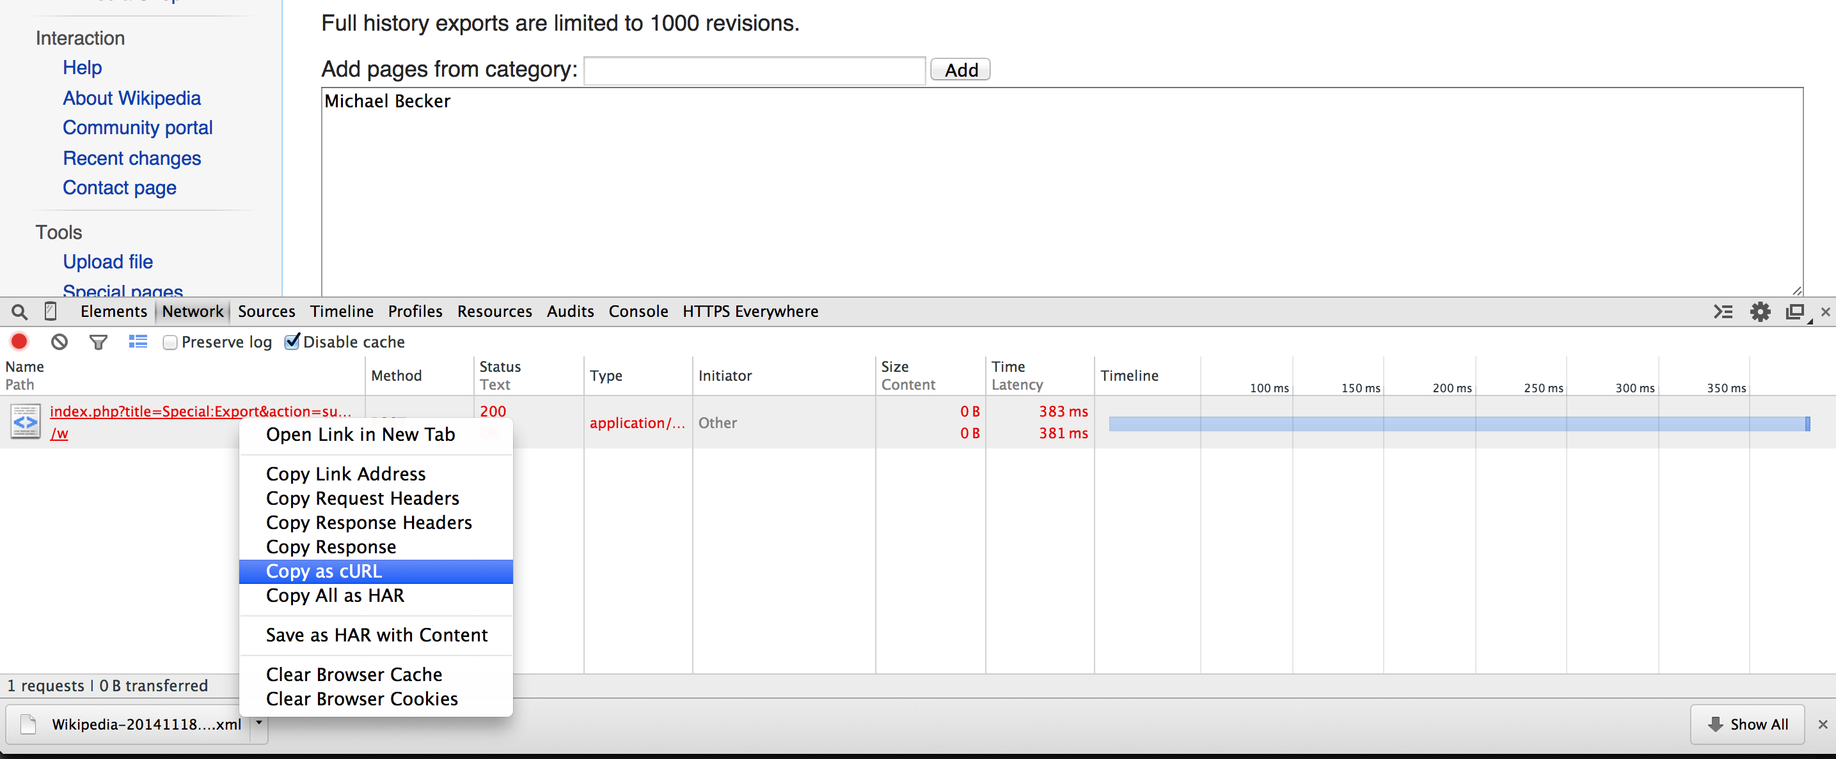
Scrape All The Things!
@beckerfuffle
#PyDataNYC
Notes:
This task was made easily scriptable via the use of the “Copy as cURL” command in the Chrome Developer Tools.

Slide 22
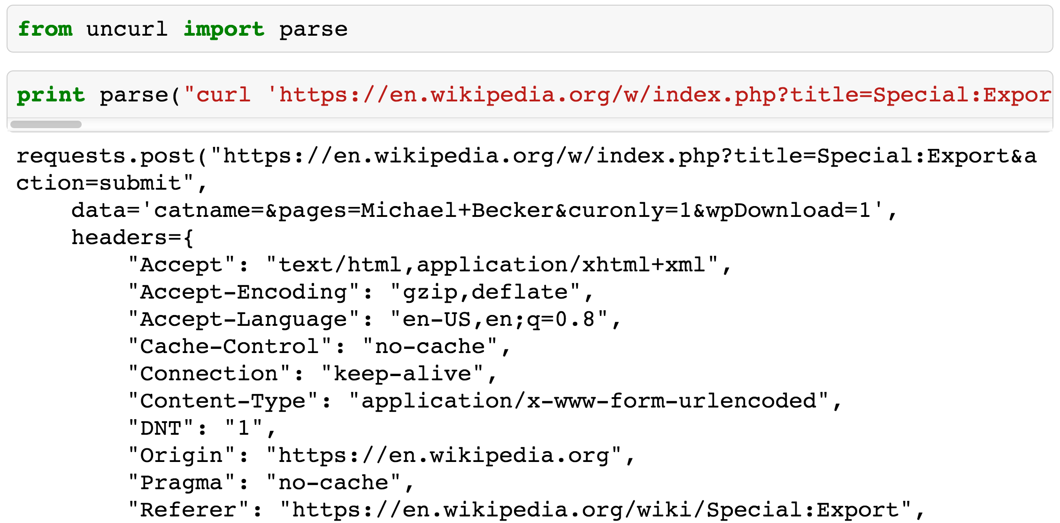
Scrape All The Things!
@beckerfuffle
#PyDataNYC
Notes:
Add to this the nifty uncurl library, and you have an instant Python bot!

Slide 23

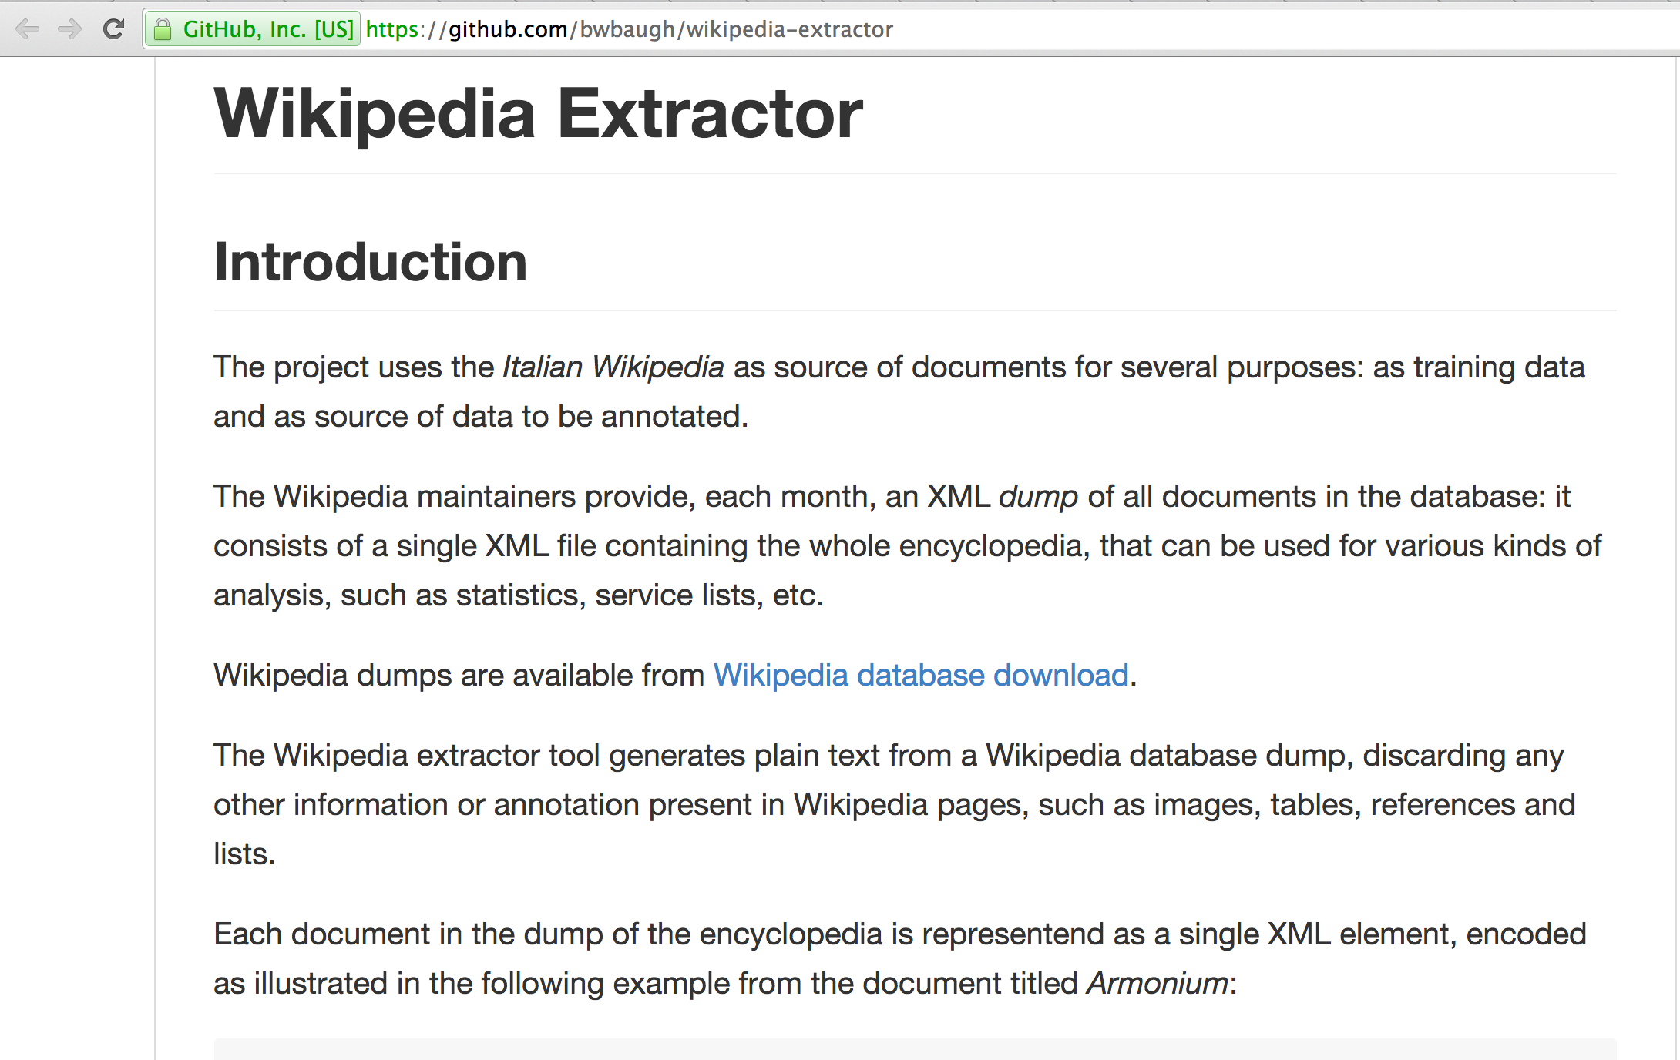
Scrub
@beckerfuffle
@beckerfuffle
#PyDataNYC
#PyDataNYC
Notes:
Now that we have our data, we need to scrub it. To start, our dumps are in xml format, so we’ll need to pull the articles out of the xml.

Slide 24
Scrub
@beckerfuffle
#PyDataNYC
Notes:
Luckily I found some Python code that already does this called wikipedia-extractor.

Slide 25
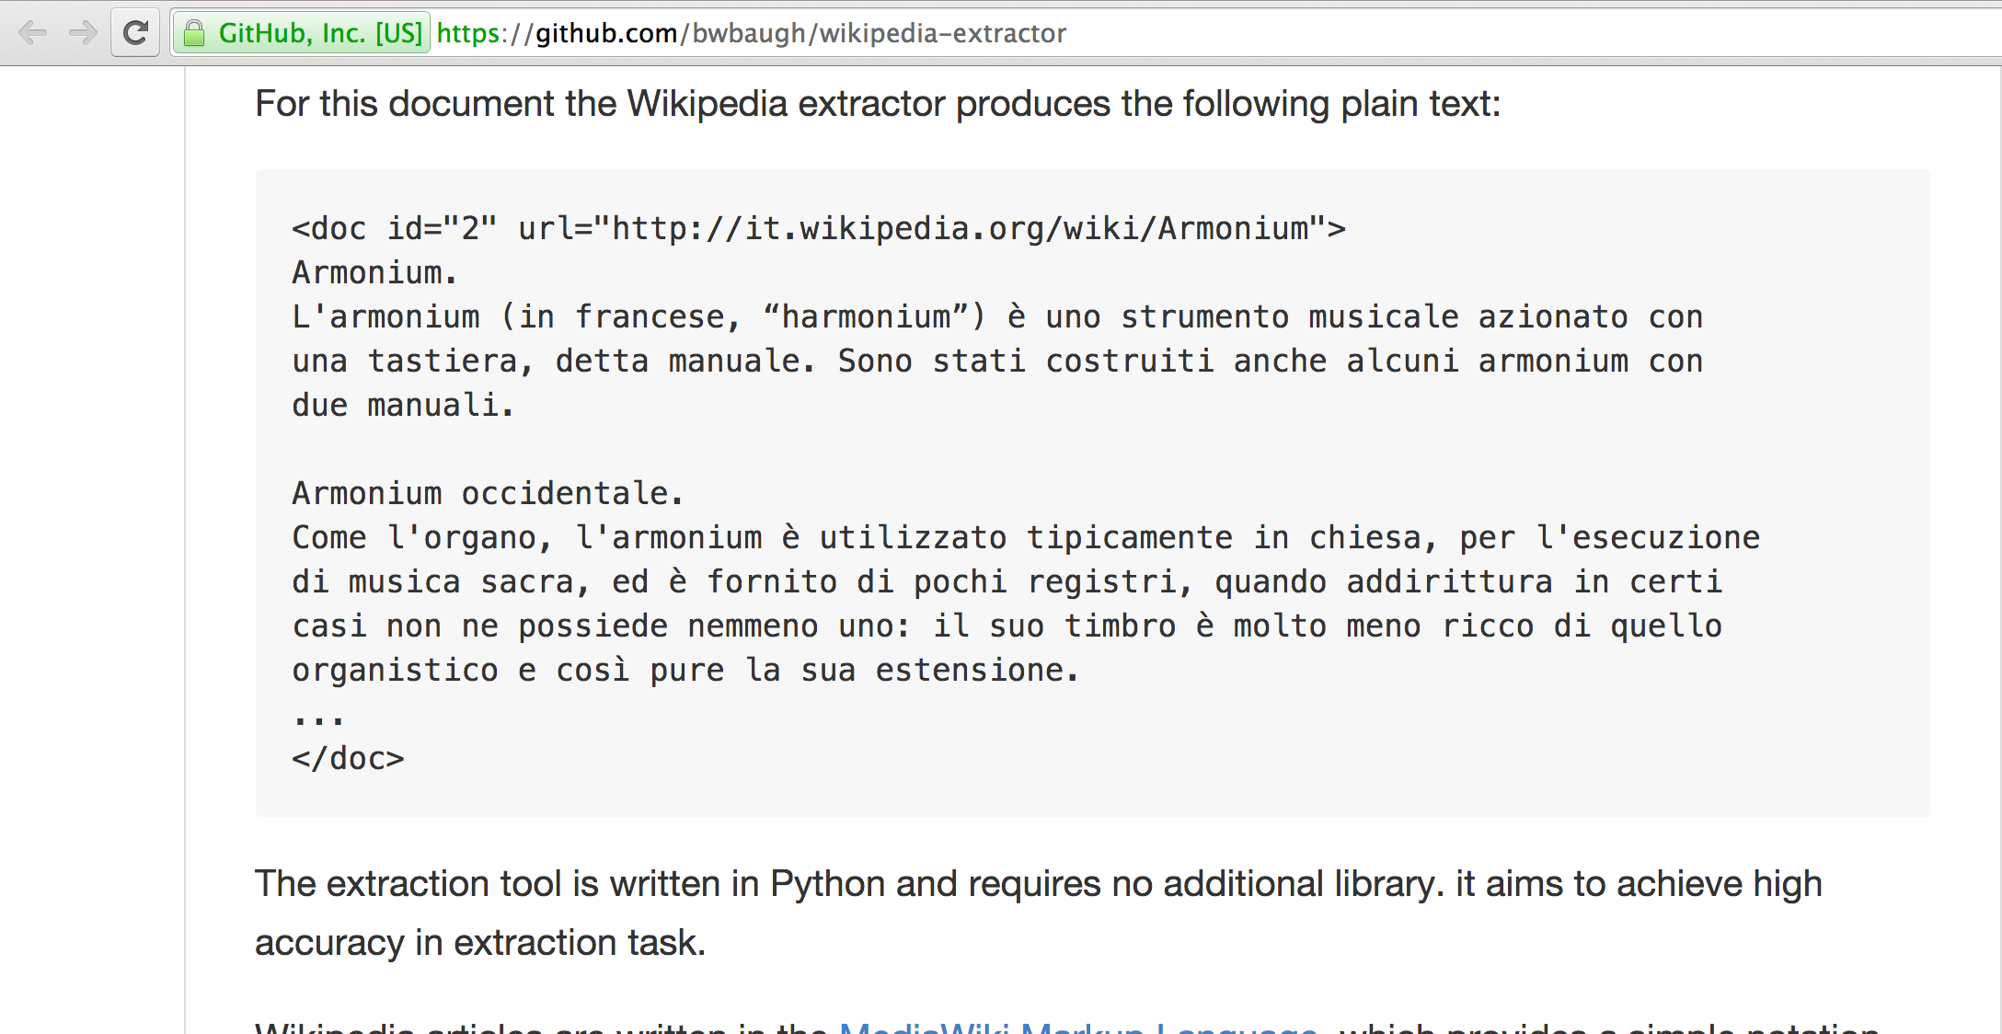
Scrub
@beckerfuffle
#PyDataNYC
Notes:
This tool produces output that looks a lot like valid XML, but it’s not!

Slide 26
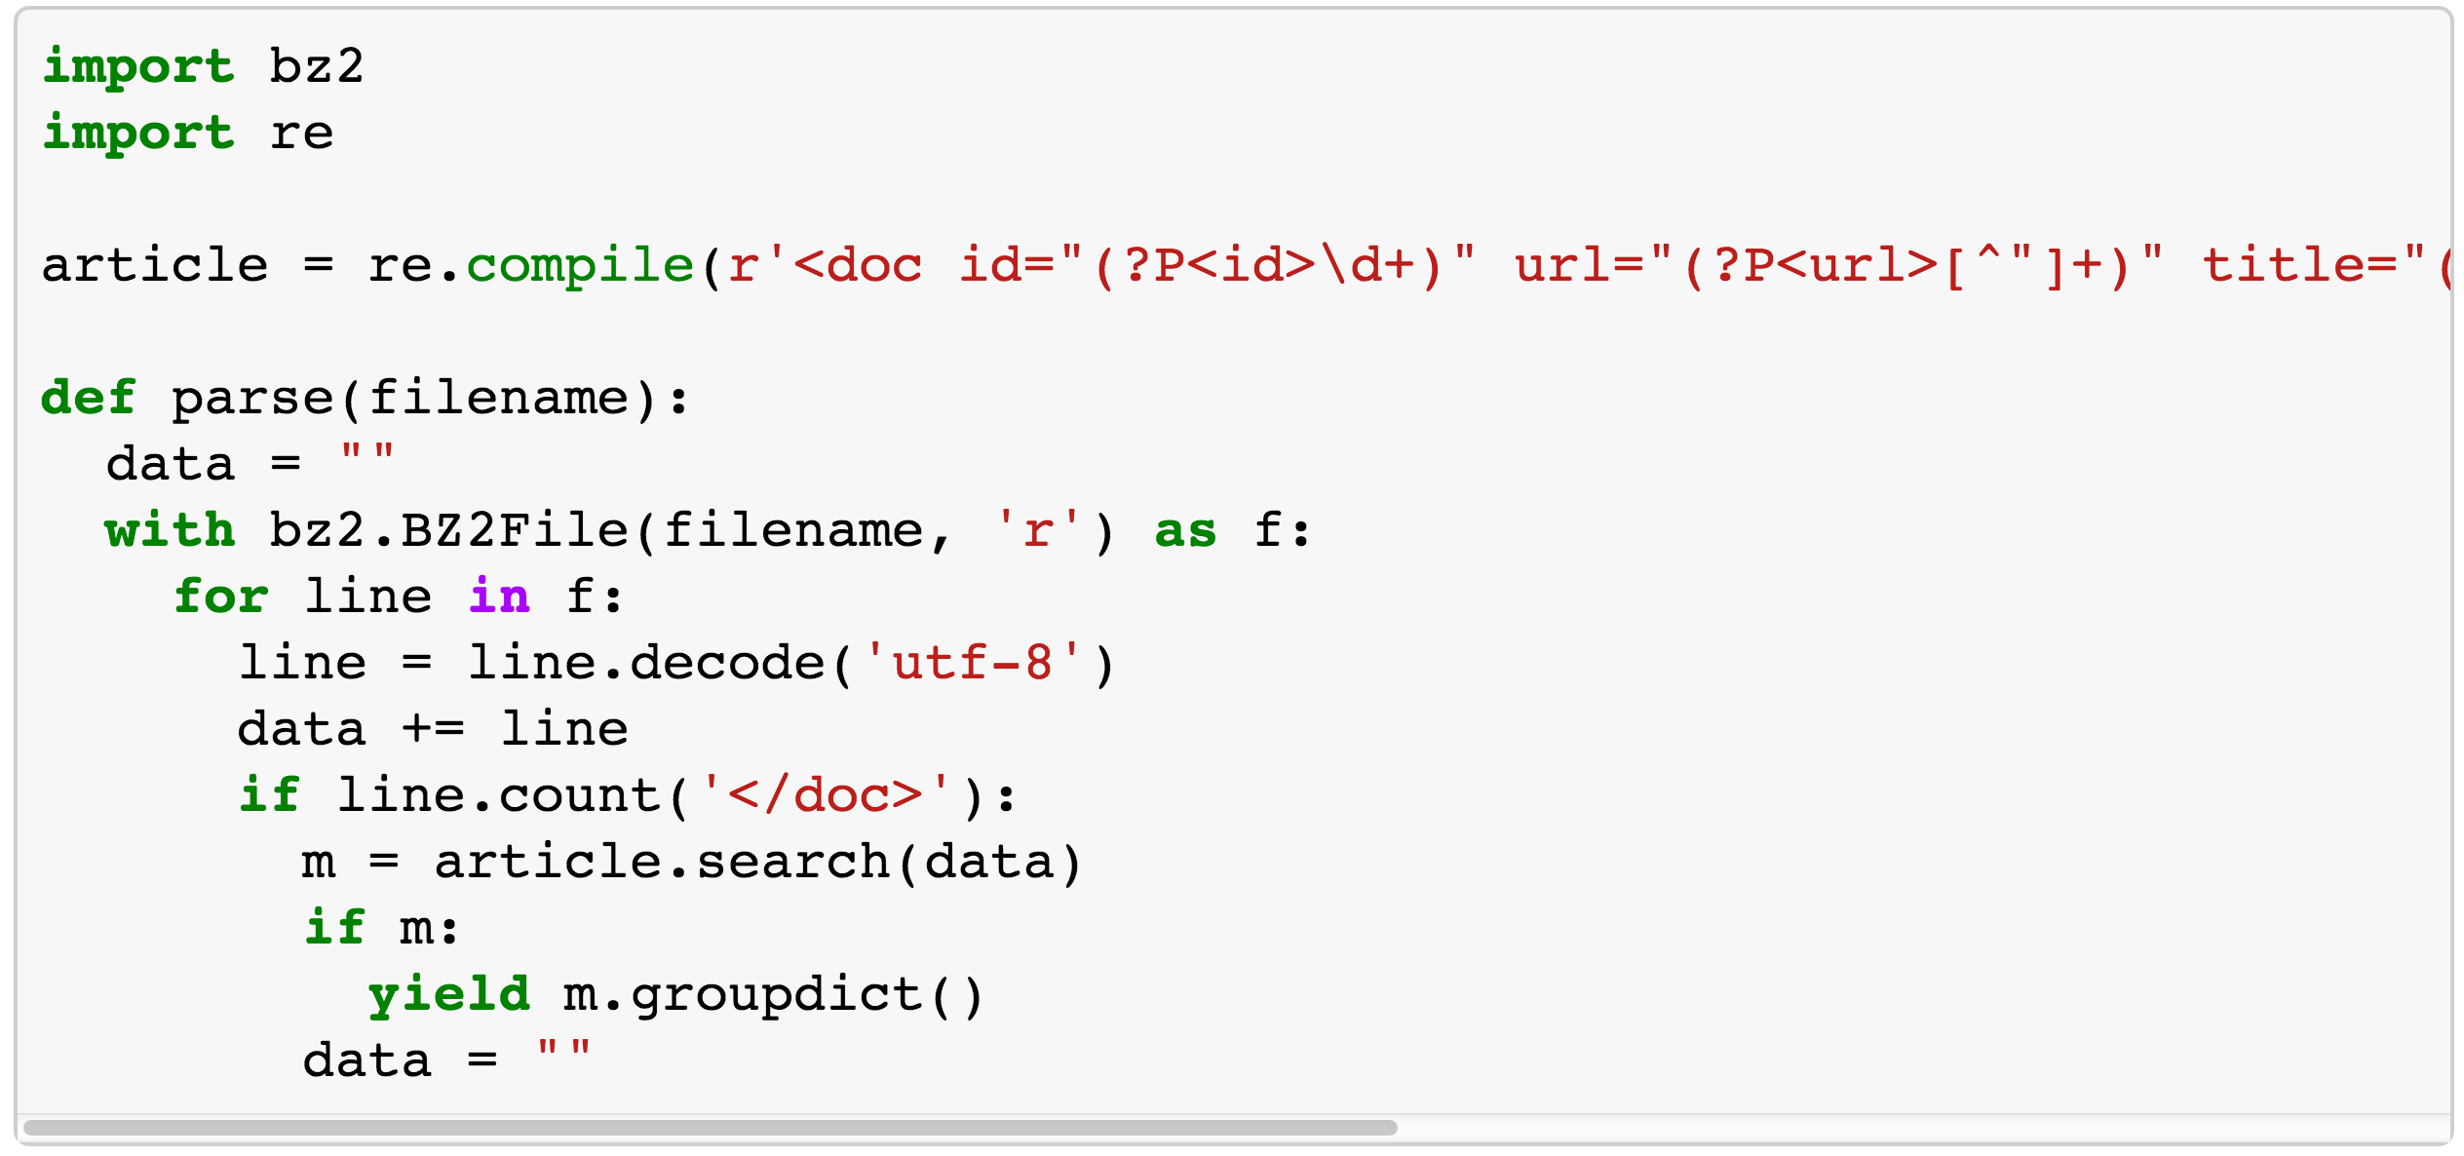
Scrub
@beckerfuffle
#PyDataNYC
Notes:
The code was a bit ugly, so rather than try and fix it I just wrote a simple regex to parse it!

Slide 27

Explore
@beckerfuffle
@beckerfuffle
#PyDataNYC
#PyDataNYC
Notes:
Alright, now that we finally have some data, let’s explore!

Slide 28
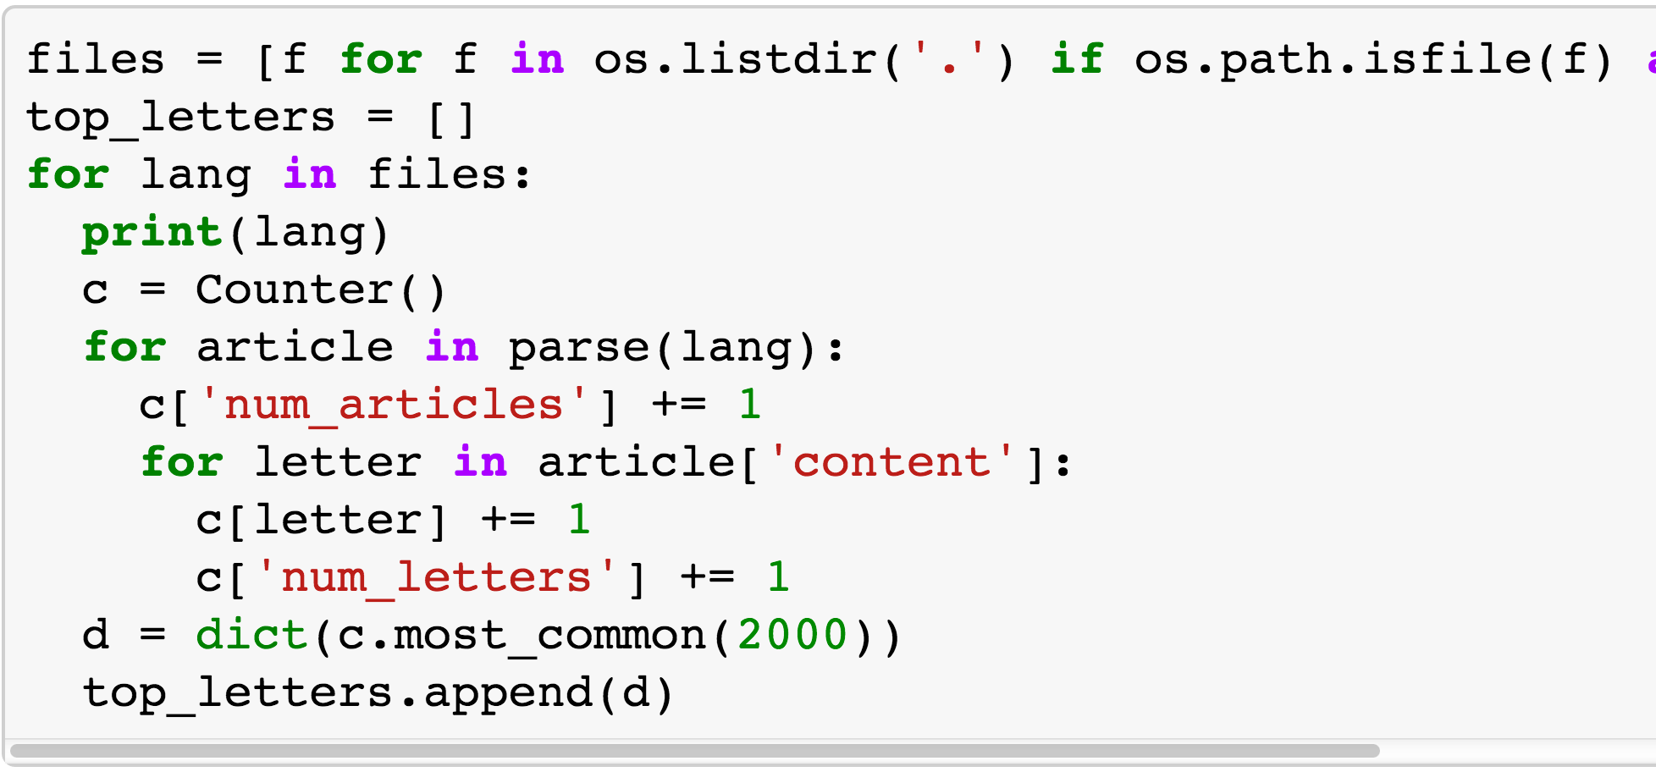
Explore
@beckerfuffle
#PyDataNYC
Notes:
To start off, I counted the number of times each character occurs in each language and grabbed the top 2000 from each.

Slide 29
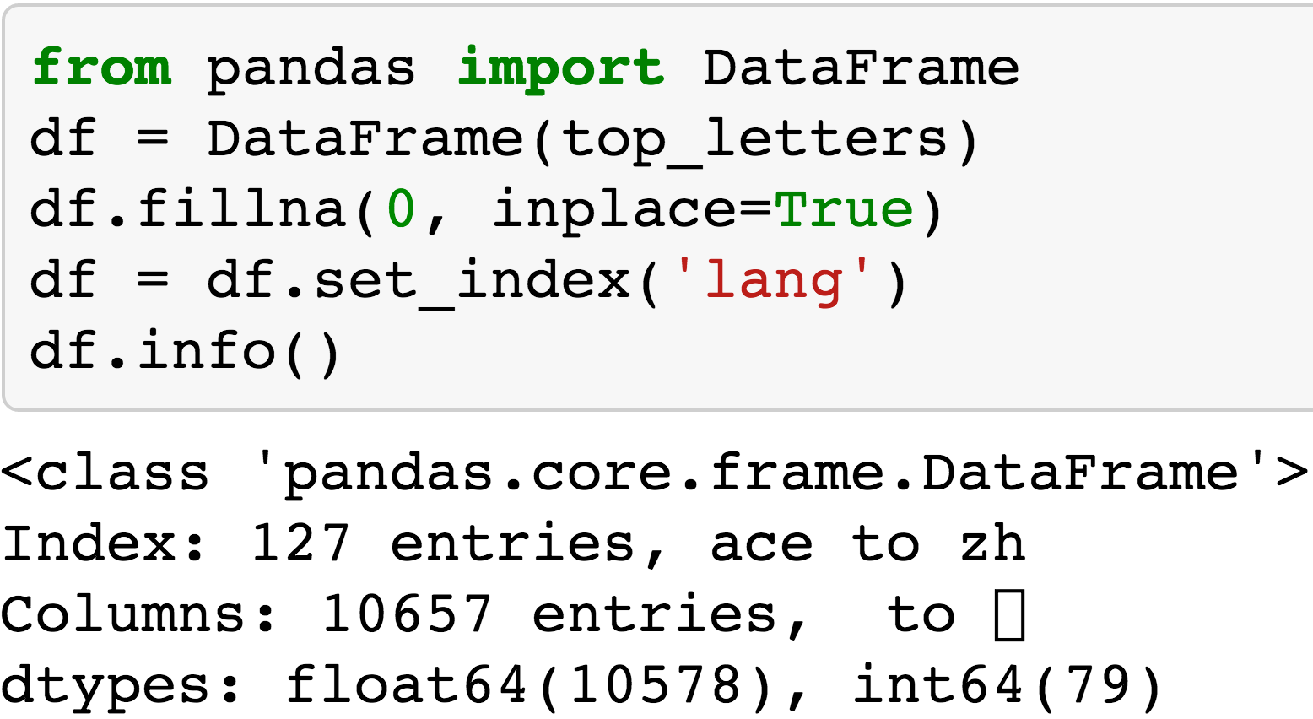
Pandas
@beckerfuffle
#PyDataNYC
Notes:
Storing the data as a list of dictionaries makes it easy to load into a pandas DataFrame! Think of a DataFrame as a mix between an Excel spreadsheet and a SQL database, but Python.

Slide 30
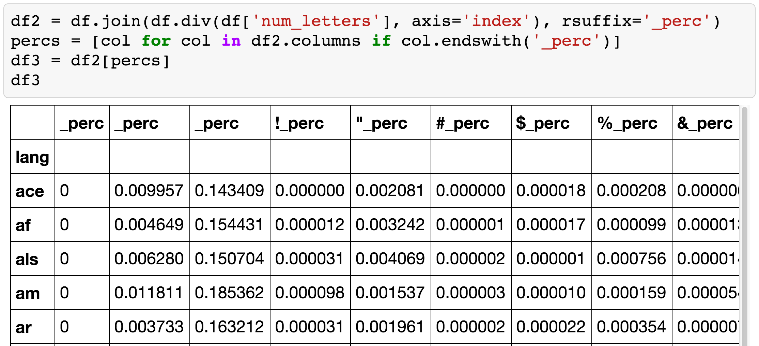
Pandas
@beckerfuffle
#PyDataNYC
Notes:
We can calculate percentages from our letter counts using the div method.

Slide 31
Pandas
@beckerfuffle
#PyDataNYC
Notes:
We can add these to as new columns to our DataFrame using the join method. If you’re using Pandas in IPython-Notebook, you can easily display the contents for inspection.

Slide 32
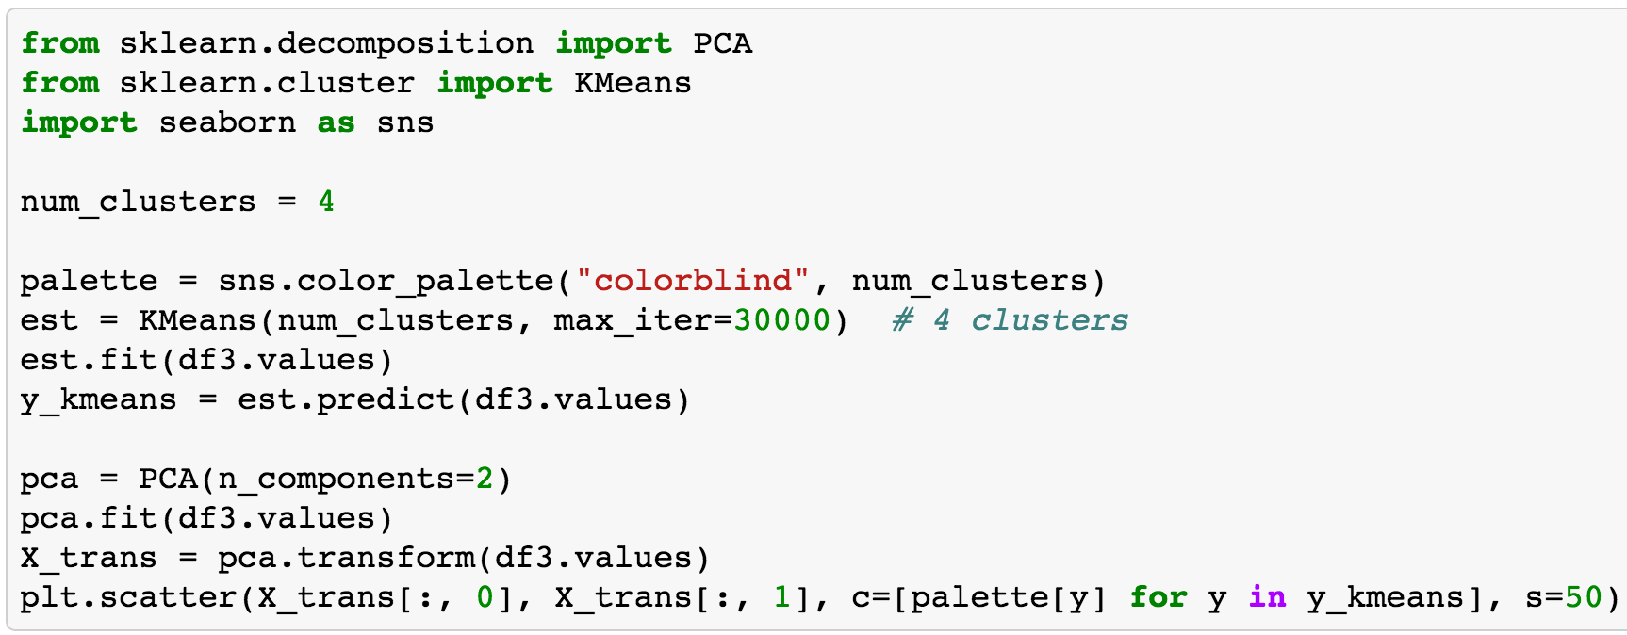
Visualize
@beckerfuffle
#PyDataNYC
Notes:
Alright so now let’s use 2 unsupervised machine learning techniques, and matplotlib to visualize our data.
There’s a lot going on here, so let’s break it down a little.

Slide 33
Visualize
@beckerfuffle
#PyDataNYC
Notes:
First we run the KMeans clustering algorithm on our letter percentages. KMeans automatically groups our data together based on similarity.

Slide 34
Visualize
@beckerfuffle
#PyDataNYC
Notes:
Next we run an algorithm called Principal Component Analysis on our data. We’re using PCA to reduce our number of columns from around 10-thousand, to 2. The reason for this will become clearer in the next slide.

Slide 35
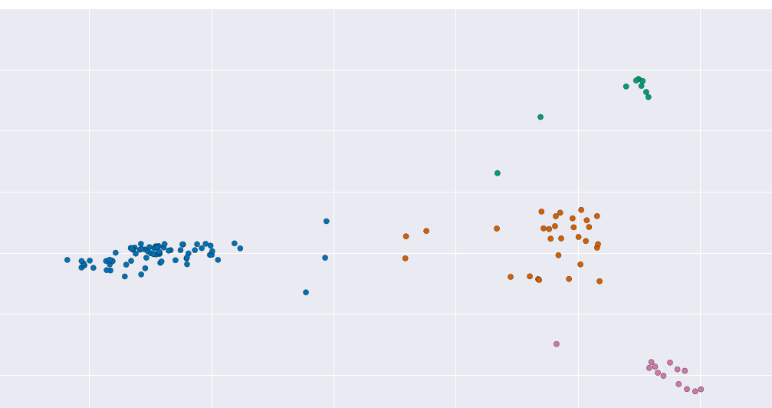
Visualize
@beckerfuffle
#PyDataNYC
Notes:
Finally we plot the results. Since our data only has 2 dimensions, it’s easy to plot! The color of each point corresponds to its cluster number. We can see that with 4 clusters, there is a pretty clear separation of our languages.

Slide 36
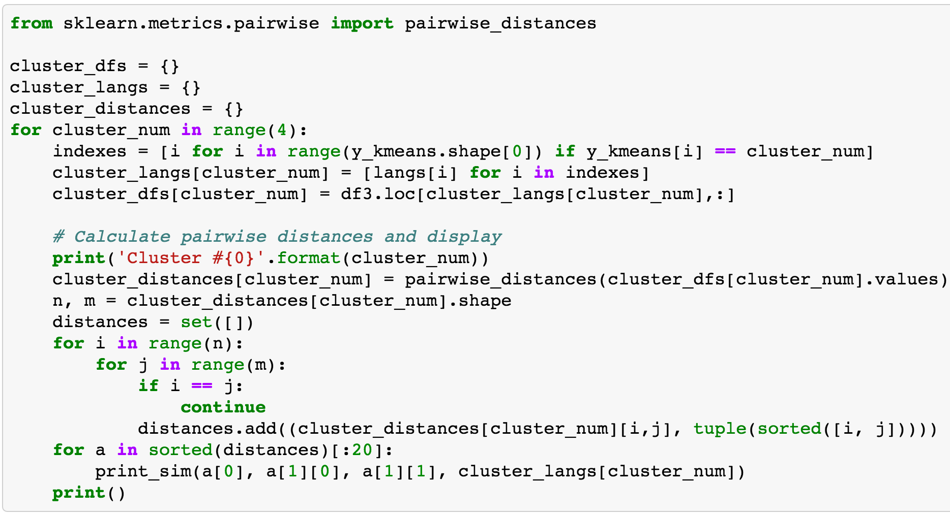
Explore More
@beckerfuffle
#PyDataNYC
Notes:
We can also use the pairwise_distances function from scikit-learn to find the languages that are most similar

Slide 37
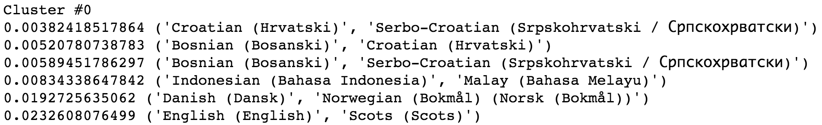
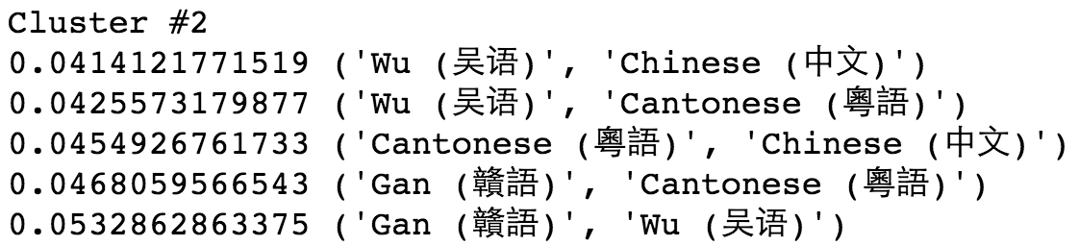
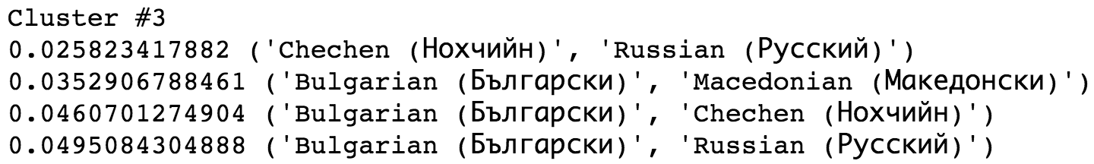
Explore More
@beckerfuffle
#PyDataNYC
Notes:
Some of these really similar languages will be useful for benchmarking our language classifier.

Slide 38
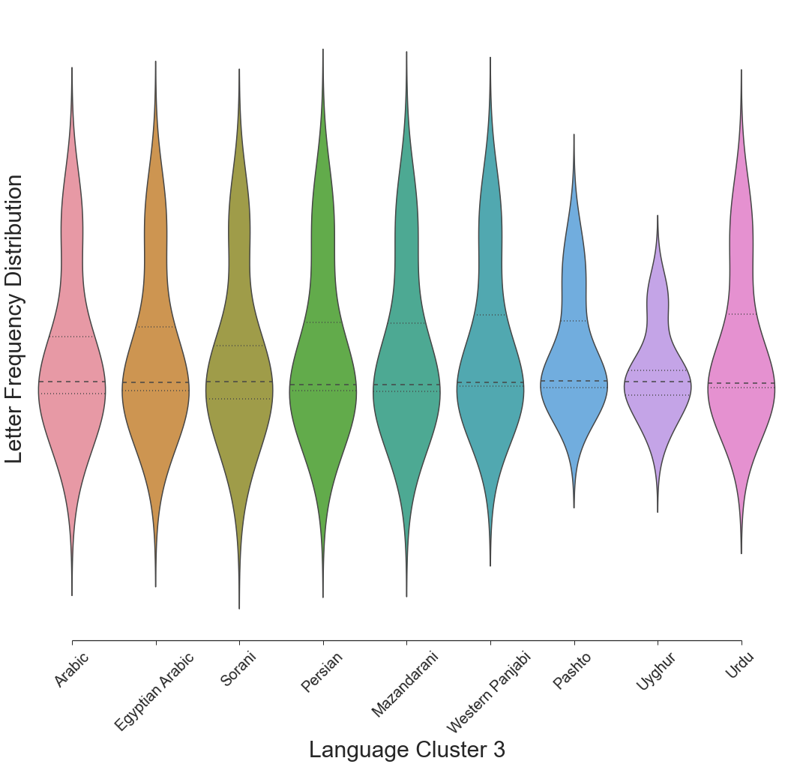
Explore Even More
@beckerfuffle
#PyDataNYC
Notes:
Finally, Seaborn has some really awesome graphs built-in which we can also use to visualize the similarity of languages. Here we have a violin plot which is similar to a box plot except it shows the distribution in addition to the 25th, 50th, and 75th percentiles.

Slide 39

Supervised Learning
@beckerfuffle
@beckerfuffle
#PyDataNYC
#PyDataNYC
Notes:
Now that we have a better understanding of our data, let’s look at training our language classifier! Our classifier is what’s called a “supervised” model. So let’s start off, by defining what a supervised model is.

Slide 40
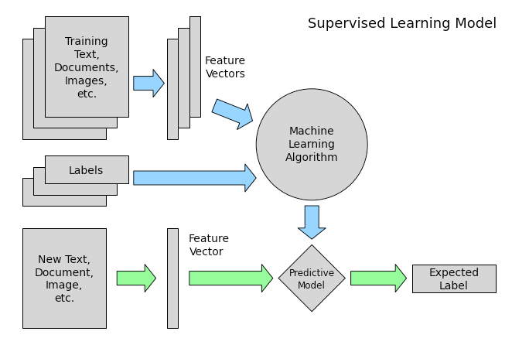
Supervised Learning
@beckerfuffle
#PyDataNYC
Notes:
1) You start off with some input. In our case we have Wikipedia articles as input. This is called the training set.

Slide 41
Supervised Learning
@beckerfuffle
#PyDataNYC
Notes:
2) You also have labels for each piece of training data. In our case our labels are the languages.
Notice how this differs from our KMeans clustering algorithm from before. KMeans didn’t use the labels. That what makes it unsupervised.

Slide 42
Supervised Learning
@beckerfuffle
#PyDataNYC
Notes:
3) Next you convert the data to a numerical form.

Slide 43
Supervised Learning
@beckerfuffle
#PyDataNYC
Notes:
4) Then you train your machine learning algorithm using your vectorized training data, and the labels as input. This is often referred to as fitting your model.
5) At this point you have a model that can take a new piece of unlabeled data, and predict the label.
Alright, so let’s see how this works in practice.

Slide 44
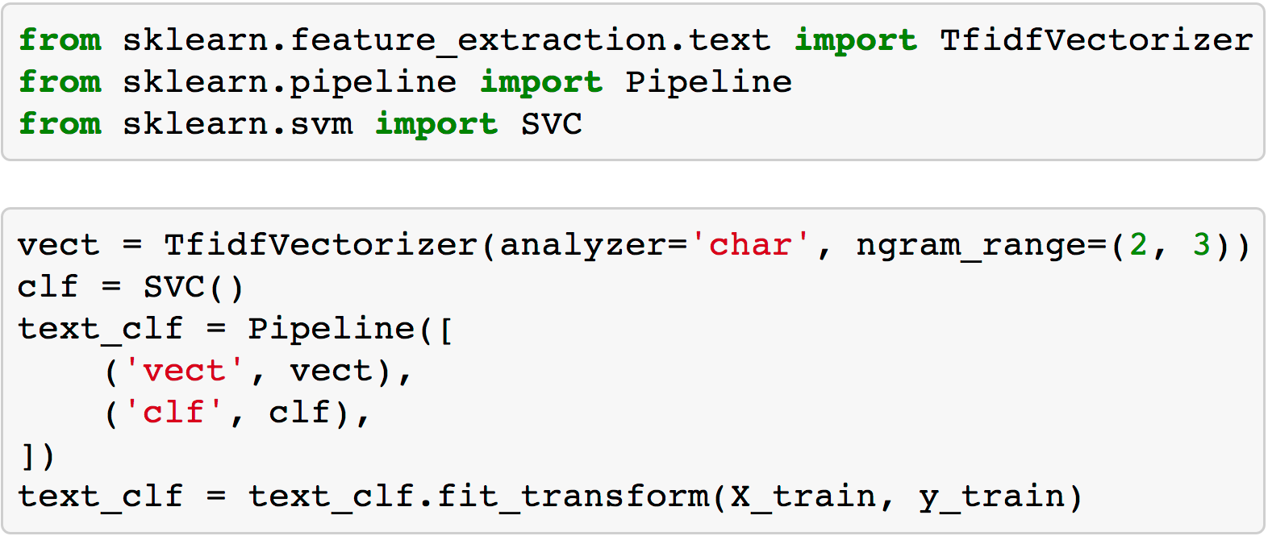
The Model
@beckerfuffle
#PyDataNYC
Notes:
We call this type of algorithm a classifier because you provide some input and it classifies it as one of multiple classes. In the case of our algorithm, you provide some text as input, and it will classify the language of the text.

Slide 45
The Model
@beckerfuffle
#PyDataNYC
Notes:
To start off I've defined a pipeline combining a TfidfVectorizer with a SVC classifier. A pipeline is a utility used to build a multi-stage classifier.

Slide 46
The Model
@beckerfuffle
#PyDataNYC
Notes:
The vectorizer converts Wikipedia articles into numerical form by counting all the combinations of n character sequences in the dataset. These are called n-grams. It then applies the TF-IDF algorithm. The pipeline understands how to connect the output of the vectorizer to the input of the SVC algorithm.

Slide 47
The Model
@beckerfuffle
#PyDataNYC
Notes:
All that’s left to do is fit our data to our model.
Let’s look a little closer and X_train and y_train.

Slide 48
Supervised Learning
@beckerfuffle
#PyDataNYC
Notes:
X_train is a portion of my data that I set aside for training.

Slide 49
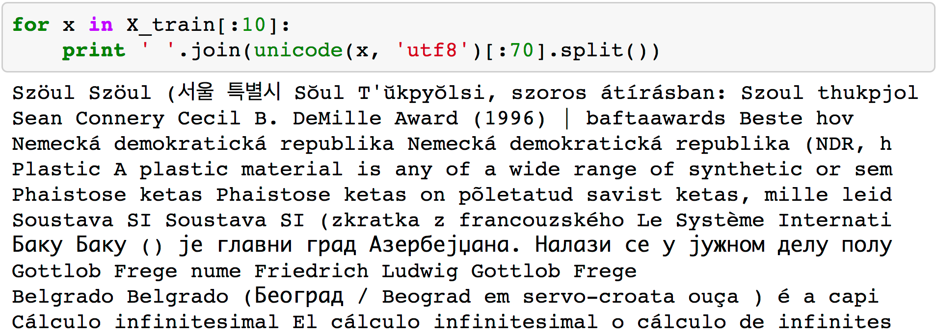
X_train
@beckerfuffle
#PyDataNYC
Notes:
X_train is an array of text from the wikipedia articles... besides stripping out the wiki markup, I didn’t do anything else to prepare the data. The vectorizor handles converting the text to the numerical form required by the SVC algorithm.

Slide 50
Supervised Learning
@beckerfuffle
#PyDataNYC
Notes:
y_train is the labels for our training set.

Slide 51
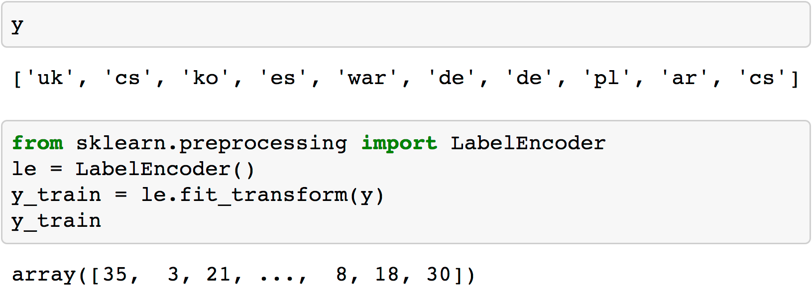
y_train
@beckerfuffle
#PyDataNYC
Notes:
y is a 1-dimensional array, in this case, it contains the language of each article. Unlike X_train, I do need to convert these to numerical form prior to passing them into the fit method.
For each wikipedia page in X_train, there is a corresponding label in y_train.

Slide 52
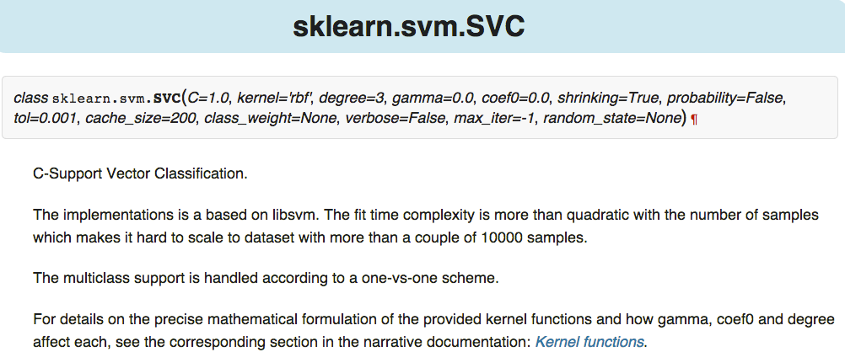
Tuning
@beckerfuffle
#PyDataNYC
Notes:
scikit-learn comes with a ton of algorithms built-in, and many of them have multiple parameters you can tweak. It can be daunting to figure out which algorithm to use and what values to pick for the parameters.

Slide 53
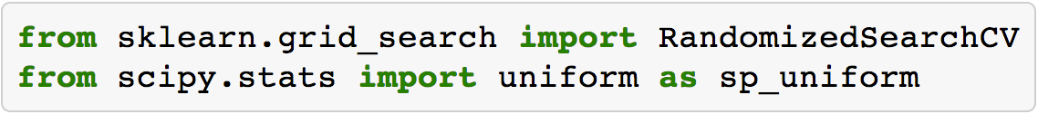
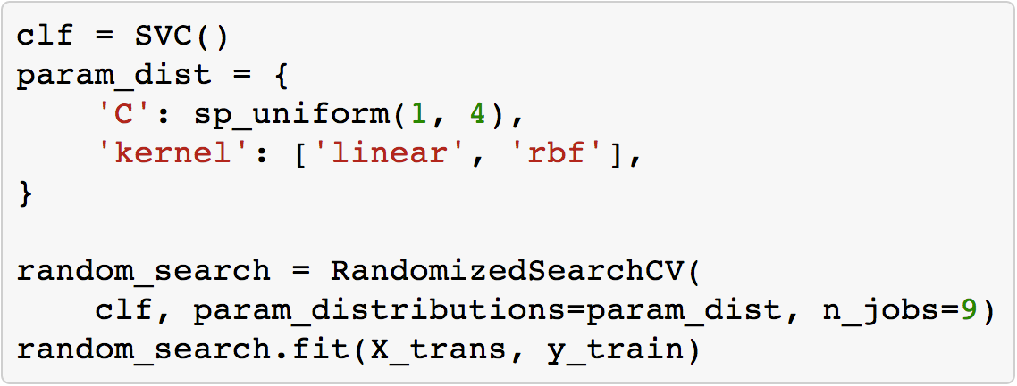
RandomizedSearchCV
@beckerfuffle
#PyDataNYC
Notes:
Luckily there are tools built-in to scikit-learn to help you tune your model so that you get the best performance out of it. One such tool is RandomizedSearchCV. You give RandomizedSearchCV a range of values to try for each parameter. It then randomly chooses values and tests them. It also runs cross-validation to help ensure you aren’t overfitting your training set.

Slide 54
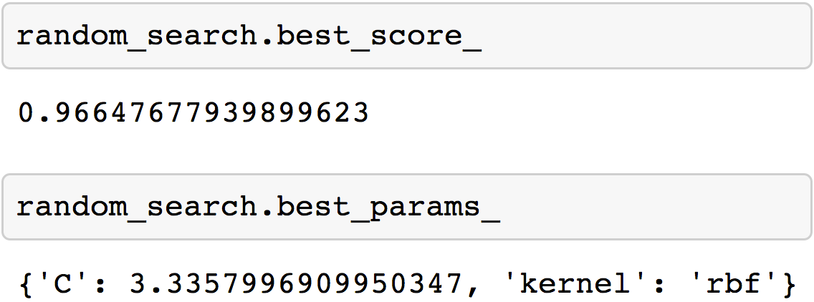
RandomizedSearchCV
@beckerfuffle
#PyDataNYC
Notes:
Once the search is complete, you can get the highest scoring classifier along with its score and parameters. You can easily run this kind of search on multiple algorithms to figure out which one will perform best for your particular dataset.

Slide 55
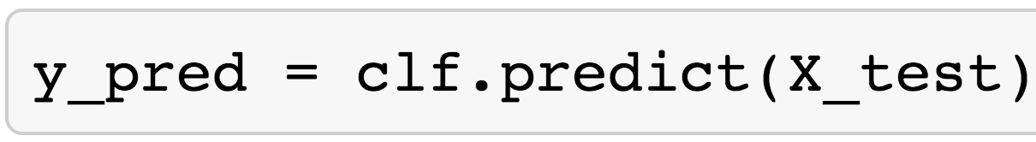
sklearn.metrics
accuracy_score
classification_report
confusion_matrix
@beckerfuffle
#PyDataNYC
Notes:
Once you have a tuned model, it’s time to validate that it’s accurate. The metrics module of scikit-learn has several utility functions for measuring classifier performance. Let’s go through a few of my favorites.
For the purposes of testing our model, I’ve excluded some of the data from training. Generally speaking, you don’t want to train an algorithm using your full dataset because many algorithms can suffer from an issue called overfitting. Overfitting is when a model is very good at making predictions about your training set, but when presented with new data, it performs poorly.

Slide 56
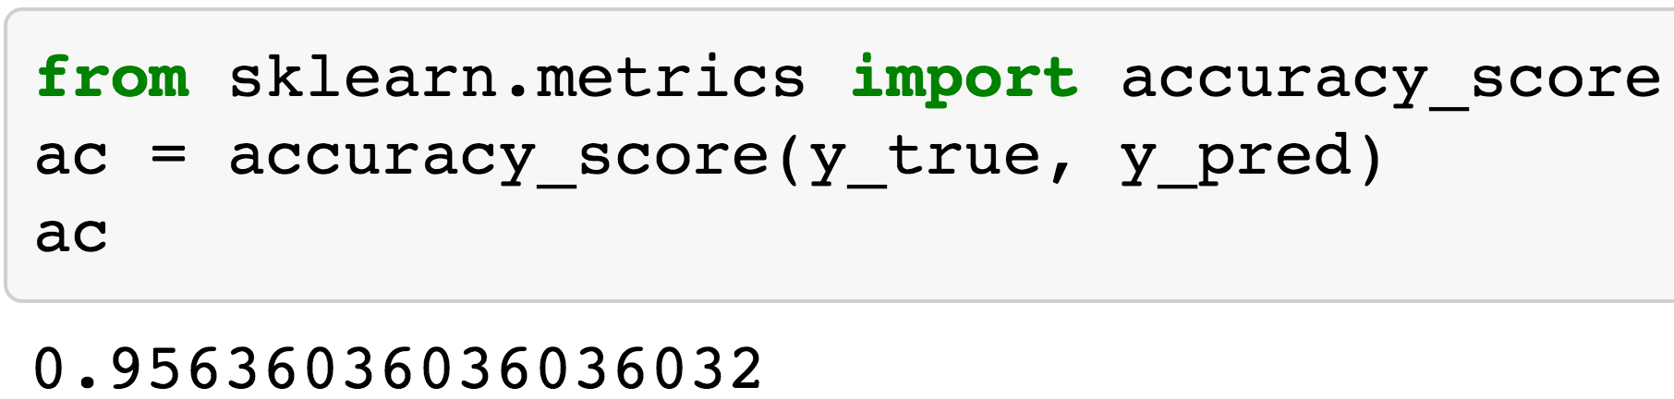
accuracy_score
@beckerfuffle
#PyDataNYC
Notes:
accuracy is pretty much what it sounds like. It’s the overall percentage of correct classifications. 96% isn’t bad, but can do better?

Slide 57
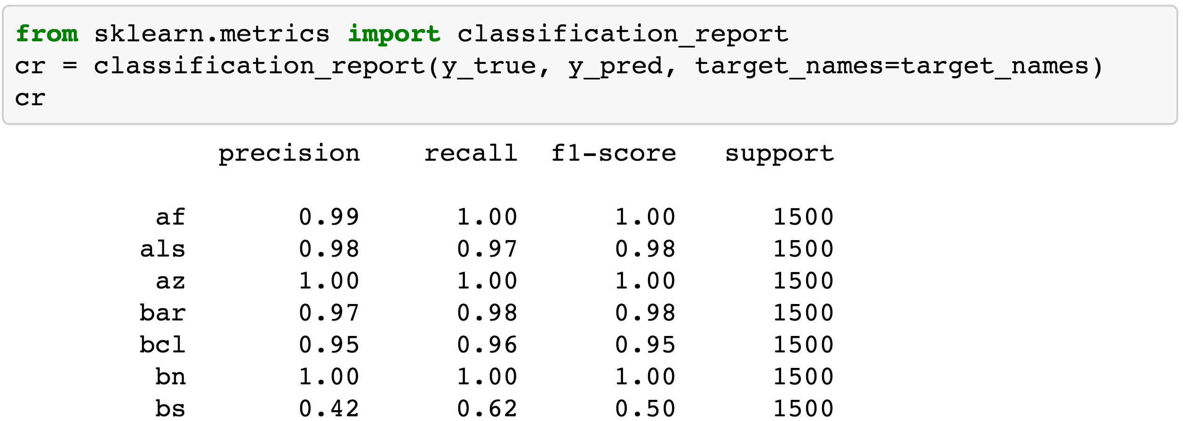
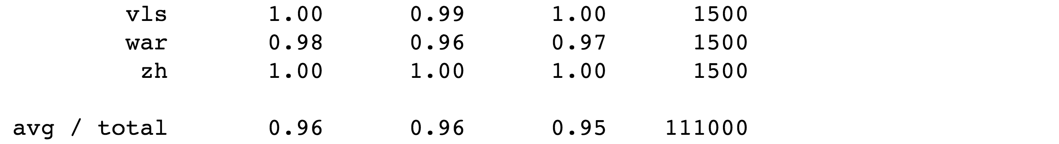
classification_report
@beckerfuffle
#PyDataNYC
Notes:
classification_report builds a text report showing “the main classification metrics.” Ideally, precision, recall, and f1-score should all have values of 1.0 (with the worst values being 0.0). Support tells you the number of samples in each class.

Slide 58
classification_report
@beckerfuffle
#PyDataNYC
Notes:
Looking at the classification report I can see right away that there is something funny going on with the Bosnian language. You might recall from the Explore phase earlier that Bosnian was very similar to a few other languages. Could this be the issue?

Slide 59
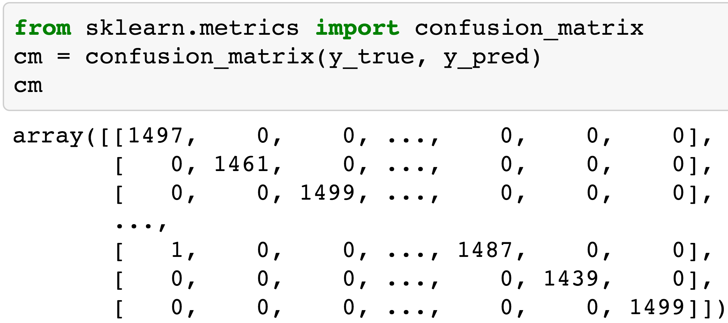
I’m Confused
@beckerfuffle
#PyDataNYC
Notes:
A good way to find patterns in the incorrectly classified data points is to use a confusion matrix. Here’s what it looks like for our classifier.
Well that’s not terribly useful. Let’s visualize it!

Slide 60
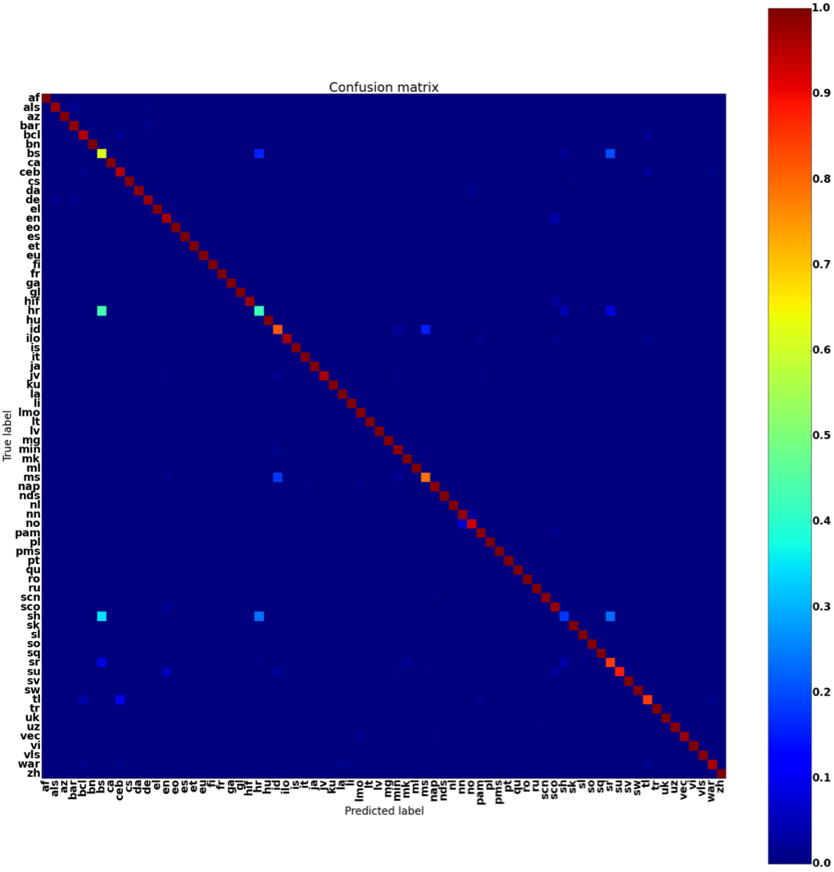
I’m Confused
@beckerfuffle
#PyDataNYC
Notes:
Okay… a little better. Let’s have a closer look.

Slide 61
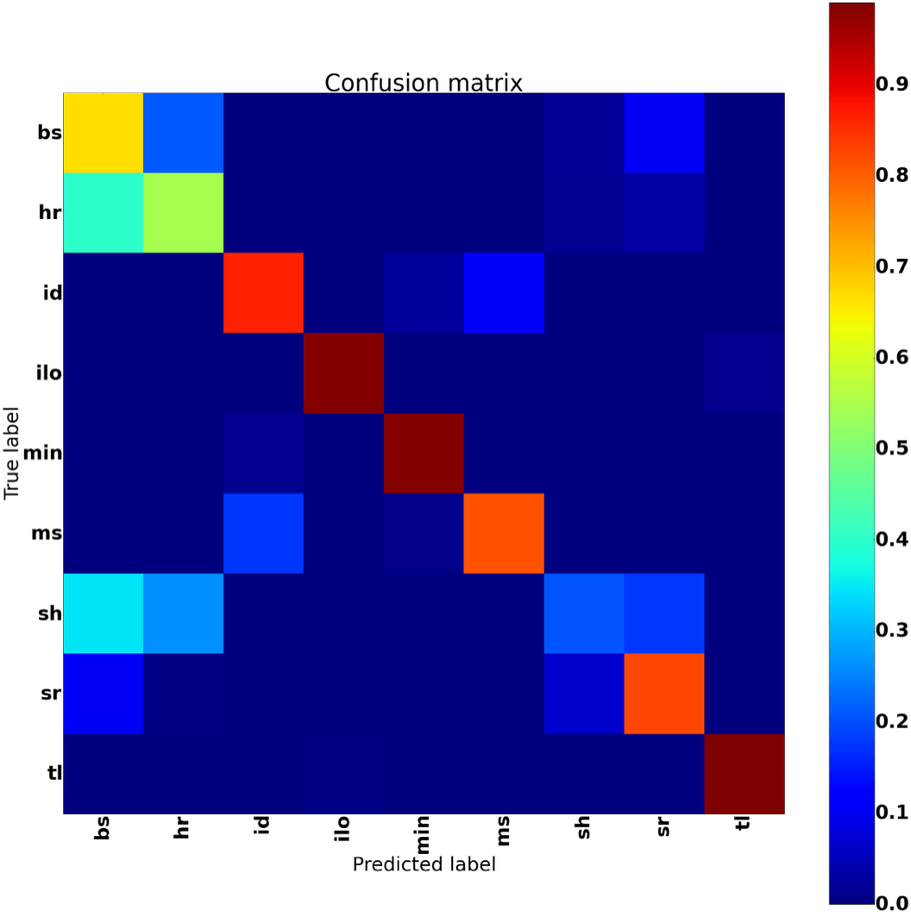
I’m Confused
@beckerfuffle
#PyDataNYC
Notes:
Alright, so how do we interpret this? The y-axis shows the correct (or true) label. The x-axis shows the predicted label. Ideally, we should see dark red along the diagonal and dark blue everywhere else. Going along the rows, we can see exactly what each language is being confused for. In this case we can see that bs, hr, sh, and sr are often being confused with each other. It turns out that these are Bosnian, Croatian, Serbo-Croatian, and Serbian. These languages are almost identical and used to all be called Serbo-Croatian prior to the Yugoslav Wars. This gives us some clues as to how we can improve the performance of our classifier.

Slide 62
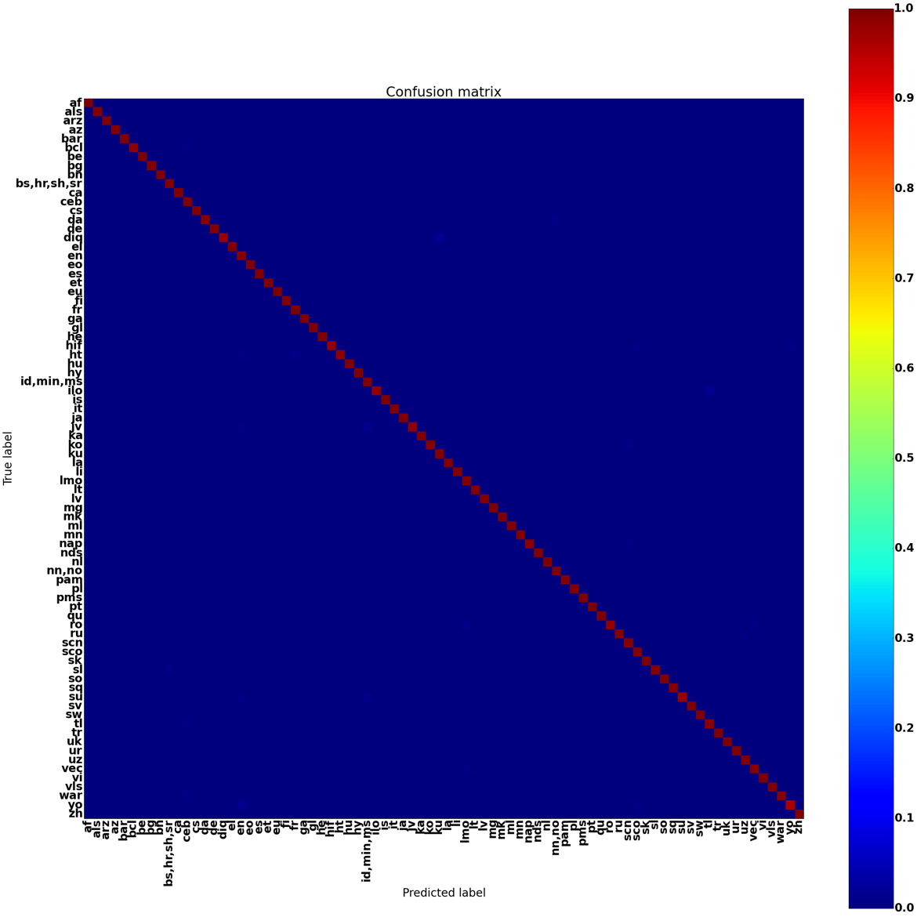
INterpret
@beckerfuffle
#PyDataNYC
Notes:
After combining several similar languages, we’re able to easily get over 99% accuracy. For some of these languages, if we wanted to distinguish them, we could get train more complex models just for them. Before devoting too much time into it, you should ask if it is worth the effort. It all comes down to your particular application.

Slide 63


My Info
Twitter: @beckerfuffle
Blog: beckerfuffle.com
Github: github.com/mdbecker
Work with me: http://aweber.jobs
@beckerfuffle
#PyDataNYC
Notes:
All right, so that’s it, now you can all go onto LinkedIn and change your titles to Data Scientist! A lot of interesting stuff didn’t make it into this talk so I’ll be posting some followups to my talk on my blog. If you’re interested in receiving email updates from me, hit me up after the Q&A and signup for my mailing list!

